Slide 1

The World Around Us: day and night

Slide 2
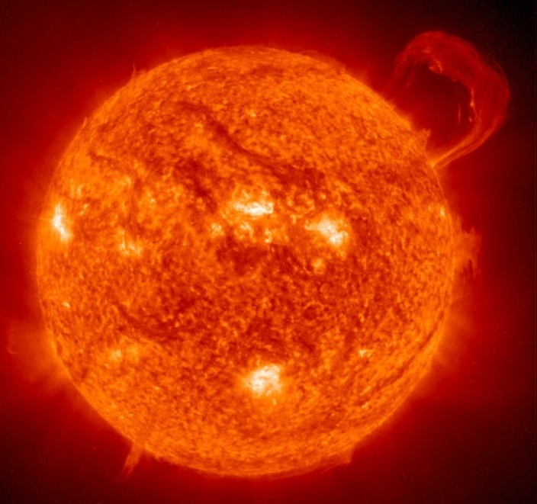
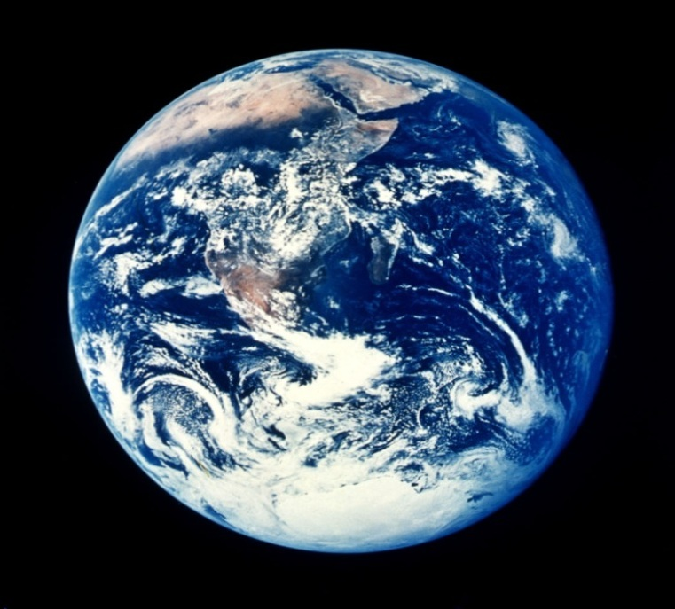
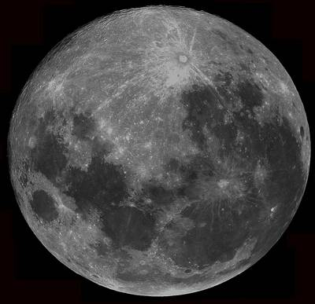
Look at these
Solar System objects
What are they?

Slide 3
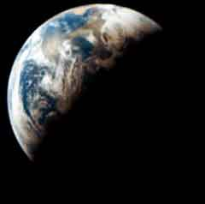
How do we get day and night?
We get daytime when a part of the Earth is pointing towards the Sun.
We get night time when a part of the Earth is pointing away the Sun.
The Earth only takes 1 day to spin around once!

Slide 4
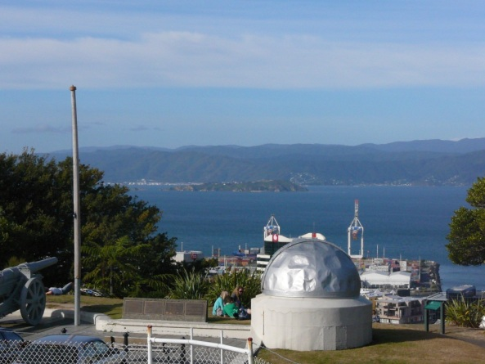
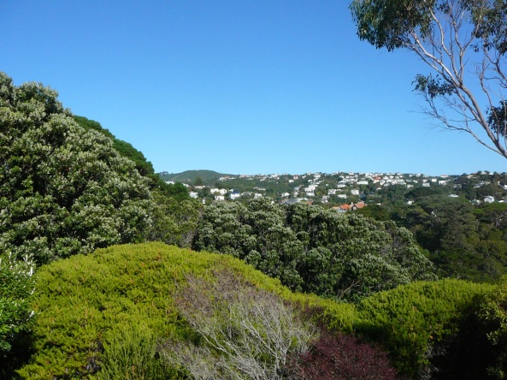
The Sun during the day
Looking East
The Sun looks like it moves across the sky during the day, but it is actually the Earth moving!
We say the sun rises in the East and sets in the West.
Where is the Sun at midday?
Looking West

Slide 5
What do we see in the day time sky?
Talk to the person next to you.
Can you think of 3 things that we see in the day time sky?
What animals are awake in the day time?

Slide 6
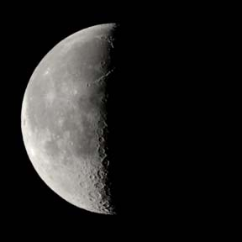
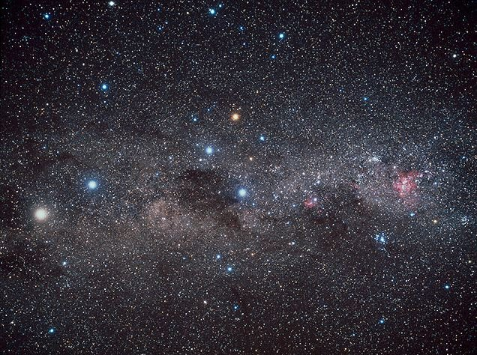
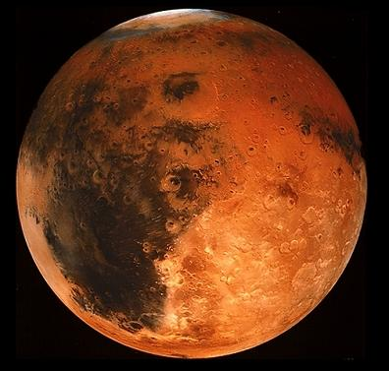
What do we see in the night time sky?
The Moon is the only object that we can easily see in the day time and the night time sky!
The Moon makes different shapes over a month. But how?

Slide 7
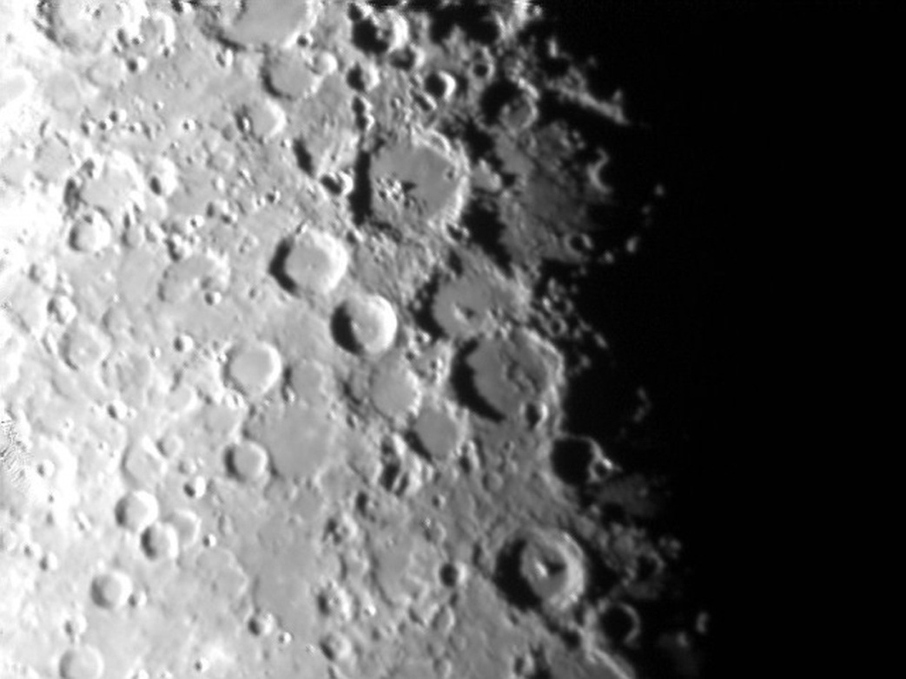
The Moon has night and day too!
It is daytime on the part of the Moon that is pointing towards the Sun.
Do you think planets have day time and night time too?
What is happening here?

Slide 8
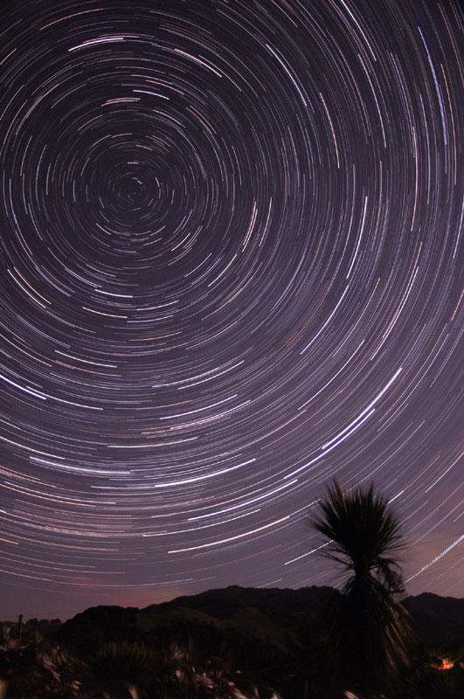
Our night time sky
The stars look like they are moving slowly at night, but actually they are still and the Earth is moving!
We say that stars rise in the East and set in the West.
What else moves East to West?
Stars turn around the South Celestial Pole.

